Slide 1

7th Grade Math
Unit 4, Lesson 10 Using Circumference and Area to Solve Problems Volume 1, pg. 171

Slide 2


Benchmarks
MA.7.GR.1.3
Explore the proportional relationship between circumferences and diameters of circles. Apply a formula for the circumference of a circle to solve mathematical and real-world problems.
MA.7.GR.1.4
Explore and apply a formula to find the area of a circle to solve mathematical and real-world problems.
volume 1, pg. 171

Slide 3
Integrated Mathematical Thinking and Reasoning Standards
MA.K12.MTR.1.1 Actively participate in effortful learning both individually and collectively.
MA.K12.MTR.3.1 Complete tasks with mathematical fluency.
MA.K12.MTR.4.1 Engage in discussions that reflect on the mathematical thinking of self and others.
MA.K12.MTR.7.1 Apply mathematics to real-world contexts.
volume 1, pg. 171

Slide 4

Learning Target
I can use the circumference and area of a circle to solve problems.
volume 1, pg. 171

Slide 5

Warm-Up
volume 1, pg. 172

Slide 6
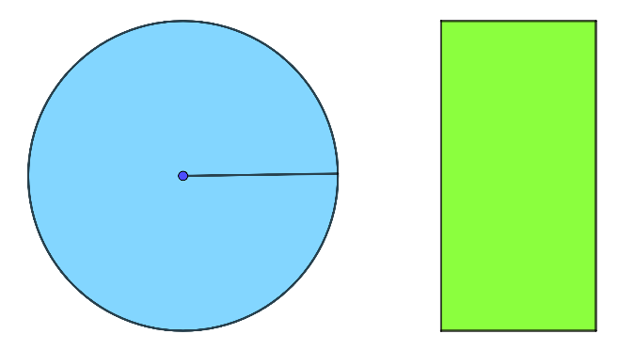


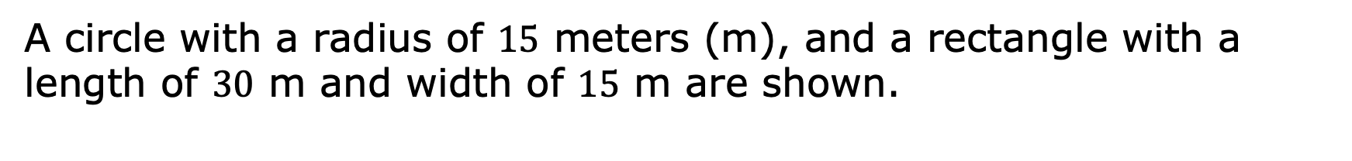

4.10.1 Warm-Up: Would You Rather?
A circle with a radius of $15$ meters (m), and a rectangle with a length of $30$ m and width of $15$ m are shown.
$15$ m
$30$ m
$15$ m
Explain if you would rather run the circumference of the circle or the perimeter of the rectangle.
volume 1, pg. 172
Notes:
Video Link: https://algebranation.wistia.com/medias/fi4fidi5y8

Slide 7

Activity
volume 1, pg. 172

Slide 8

4.10.2 Activity: Sage and Scribe
For the first problem, decide who will be the Sage and who will be the Scribe.
While working a problem, the Sage is the only one who can talk. The Scribe must write down only what the Sage says to solve the problem.
For each problem, swap who is the Sage and who is the Scribe.
volume 1, pg. 172

Slide 9
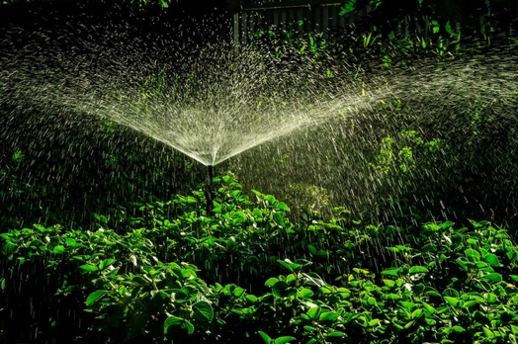
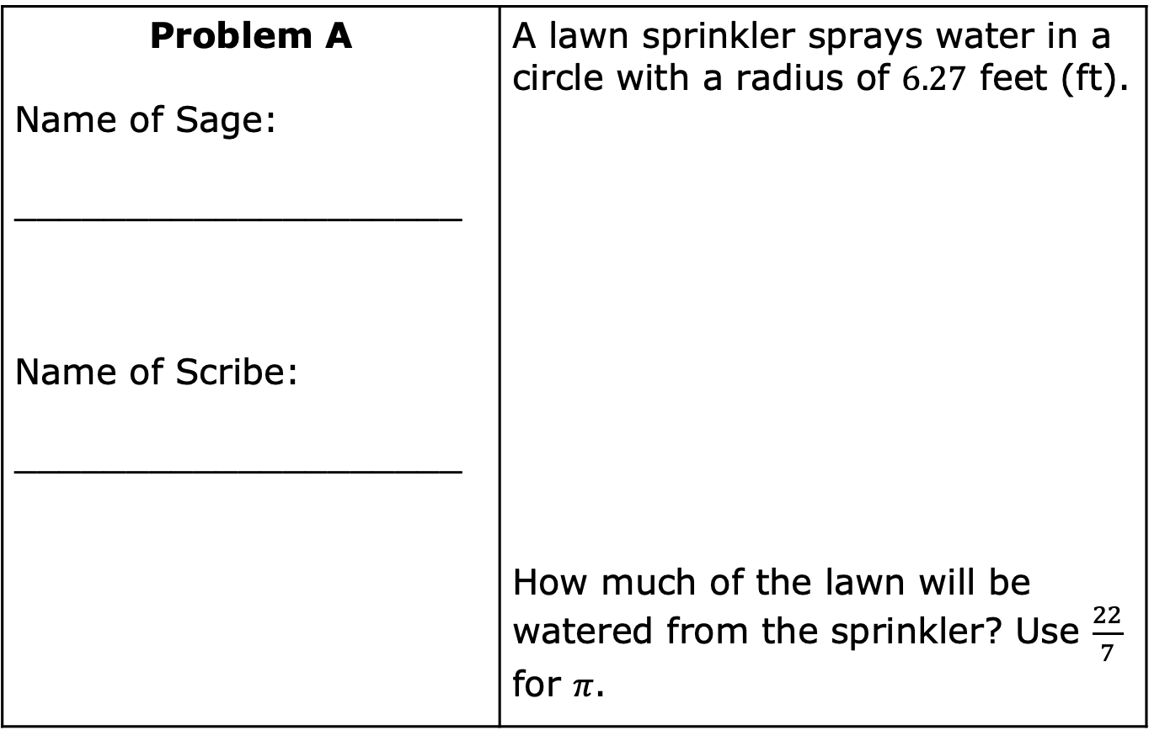
Problem A Name of Sage: ____________________ Name of Scribe: ____________________ | A lawn sprinkler sprays water in a circle with a radius of $6.27$ feet (ft). How much of the lawn will be watered from the sprinkler? Use $\frac{22}{7}$ for $π$.
volume 1, pg. 172

Slide 10
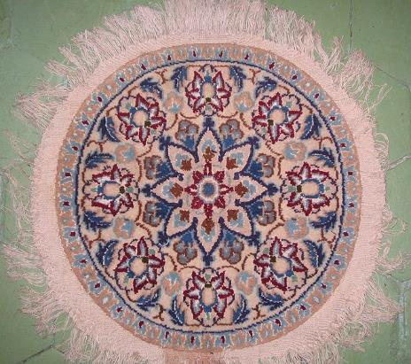
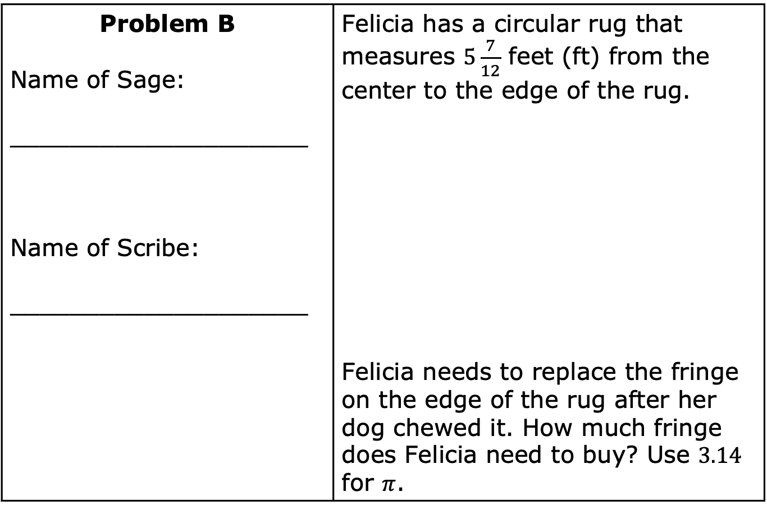
Problem B Name of Sage: ____________________ Name of Scribe: ____________________ | Felicia has a circular rug that measures $5\frac{7}{12}$ feet (ft) from the center to the edge of the rug. Felicia needs to replace the fringe on the edge of the rug after her dog chewed it. How much fringe does Felicia need to buy? Use $3.14$ for $π$.
volume 1, pg. 173

Slide 11
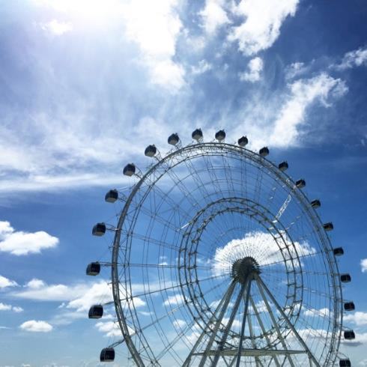
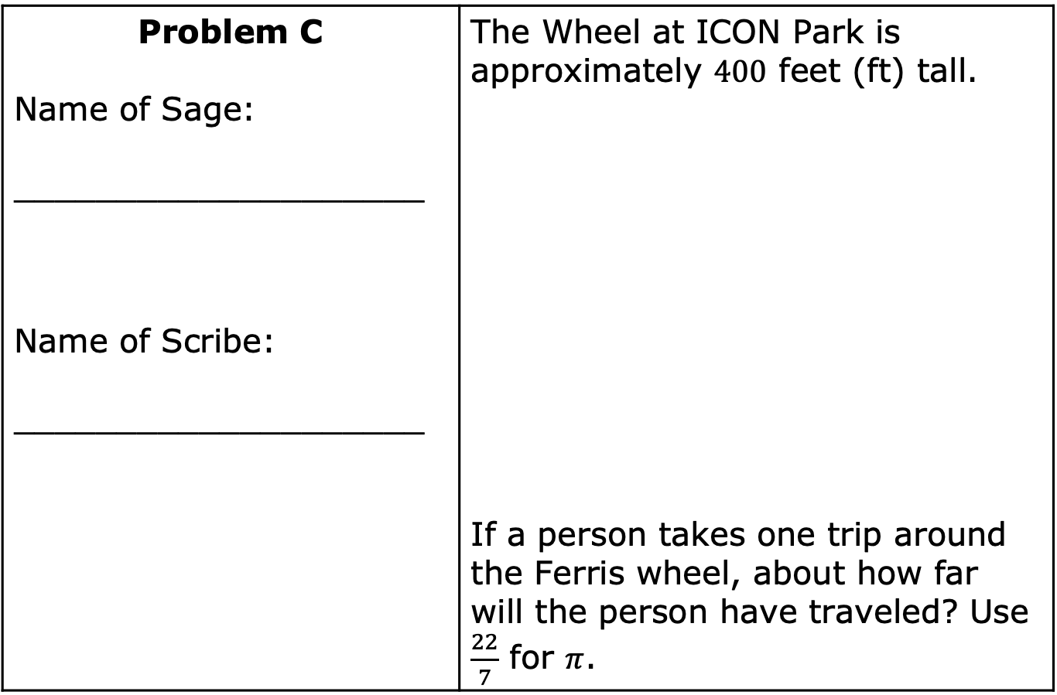
Problem C Name of Sage: ____________________ Name of Scribe: ____________________ | The Wheel at ICON Park is approximately $400$ feet (ft) tall. If a person takes one trip around the Ferris wheel, about how far will the person have traveled? Use $\frac{22}{7}$ for $π$.
volume 1, pg. 173

Slide 12
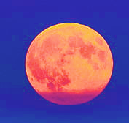
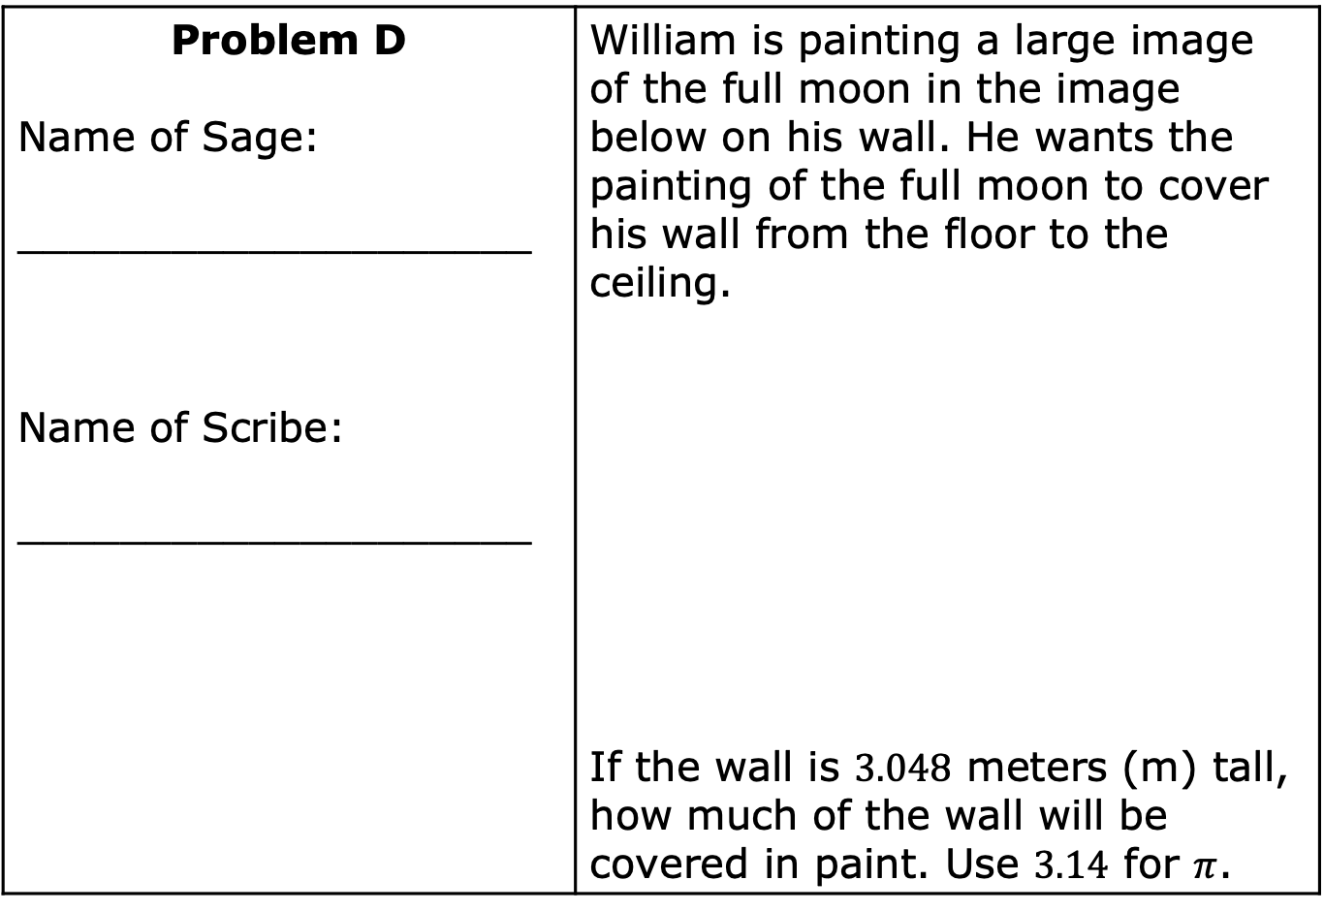
Problem D Name of Sage: ____________________ Name of Scribe: ____________________ | William is painting a large image of the full moon in the image below on his wall. He wants the painting of the full moon to cover his wall from the floor to the ceiling. If the wall is $3.048$ meters (m) tall, how much of the wall will be covered in paint. Use $3.14$ for $π$.
volume 1, pg. 174

Slide 13

Your Turn
volume 1, pg. 174

Slide 14
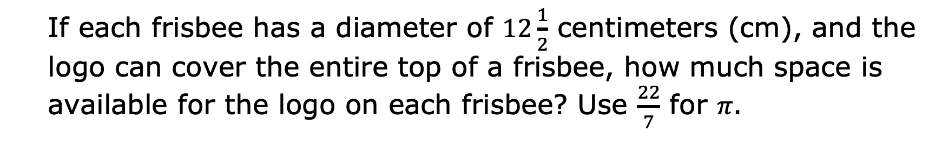
4.10.3 Your Turn!
YOUR LOGO HERE
Yvonne’s company wants to put their logo on frisbees to give away at a convention.
If each frisbee has a diameter of $12\frac{1}{2}$ centimeters (cm), and the logo can cover the entire top of a frisbee, how much space is available for the logo on each frisbee? Use $\frac{22}{7}$ for 𝜋.
volume 1, pg. 174

Slide 15
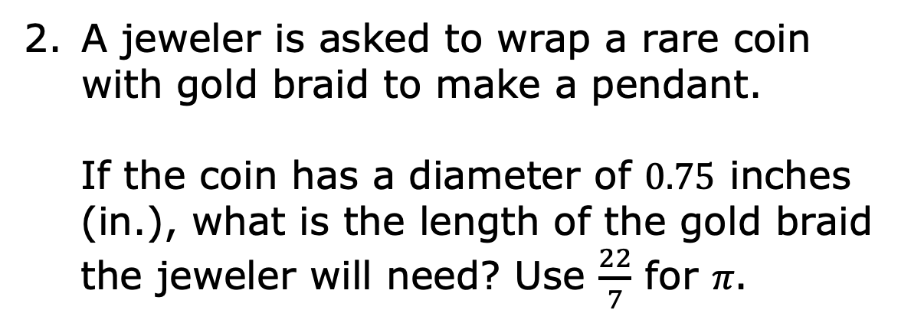
A jeweler is asked to wrap a rare coin with gold braid to make a pendant.
If the coin has a diameter of $0.75$ inches (in.), what is the length of the gold braid the jeweler will need? Use $\frac{22}{7}$ for 𝜋.
volume 1, pg. 174

Slide 16

Wrap-Up
volume 1, pg. 175

Slide 17
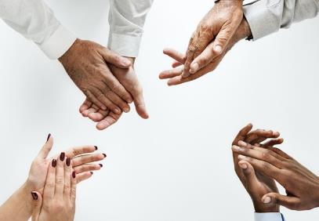
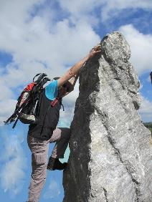
4.10.4 Wrap-Up: Reflection
Today I deserve for …
Today I by doing …
volume 1, pg. 175

Slide 18
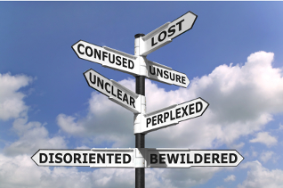
Today I was by …
volume 1, pg. 175

